Slide 1

Azure Foundation Design Solution Overview Optimus Hosting and Platform Transformation
Solution Assurance Peer Review: {Date} Review: {Date} Approval: {Date}
Template version: April 2020
Version: 0.5
Author: Sugi Kanda
Date: 25 June 2020
For Internal Use Only

Slide 2
Solution Context
The purpose of the document is to provide a high level solutions overview of the Azure Foundation Core Infrastructure, associated key design decisions and solution impact.
Background
Standard Life Aberdeen (SLA) is strategically looking to minimize its on-premise server footprint, and capitalize on the benefits of cloud based services. As part of this strategy, there is an aim to migrate more applications onto Azure to allow for optimized and enhanced cloud-based service delivery, while leveraging the cost benefits, agility and innovation of the cloud:
Reduced cost of infrastructure and services
Flexible options to manage capacity for both peak and non-peak demands
A robust Governance model for environment management
Increased automation so that the majority of requests can be automatically provisioned in minutes
Embedded security within environments to meet compliance needs as required
Charging based on the Azure consumption model, paying for use on an hourly basis with the ability to suspend servers
Enabling innovation and agility to SLA in terms of roadmap alignment plan
SLA engaged with Cognizant to complete an assessment of the on-premise estate and to set up an Azure Foundation Infrastructure which provides a cost-effective, scalable cloud-based solution for migrating applications to.
Problem Statement & Motivation
Cognizant understands that there was no exhaustive foundation design work completed in the past
Existing deployments in Azure follow no standard configurations
Existing setup can not support the large scale migration planned as part of the transformation programme
The Foundation Design is to help alleviate the problems highlighted by taking the right design decisions and subsequently facilitate the deployment of workloads to Azure

Slide 3
Solution Summary
In support of the Optimus Hosting and Transformation programme Cognizant are undertaking Hybrid Cloud Design. For the Public Cloud, an Azure Foundation solution to facilitate the implementation of Azure landing zones leveraging Microsoft’s Cloud Adoption Framework and Cognizant / Microsoft expertise. Once implemented the Azure foundation will provide a platform for delivery of new systems and the migration of on-premise systems to Azure. The Azure Foundation solution will ensure:
Security & Compliance Orientated Approach
Ensuring the implementation can adapt to change
Creating the Cloud Foundation design required for a successful Cloud adoption
Ballpark Costs
Project Delivery: £ tbc Annual Run Cost: £ tbc p.a.
Background
Standard Life Aberdeen (SLA) is strategically looking to minimize its on-premise server footprint, and capitalize on the benefits of cloud based services. As part of this strategy, there is an aim to migrate more applications onto Azure to allow for optimized and enhanced cloud-based service delivery, while leveraging the cost benefits, agility and innovation of the cloud SLA engaged with Cognizant to complete an assessment of the on-premise estate and to set up an Azure Foundation Infrastructure which provides a cost-effective, scalable cloud-based solution for migrating applications to
Key In Scope Elements
Requirements gathering and finalization on all key areas of the Azure Foundation aligned to the Microsoft Cloud Adoption Framework. (EA\Subscription, Management Groups, Networking, Identity, Security, Compute, Data, Business Continuity and Disaster Recovery, Logging, Monitoring & Alerting) Azure Foundation High Level Design
Key Out of Scope Elements
Azure Foundation Build and Transition of Azure Build into BAU Service
Key Dates/Dependencies
Azure SOD Approval at SLA DA: 09 July 2020 High Level Design Approval at IDA: 29 July 2020
Waivers/Exceptions Requested
No Waivers or exceptions requested at this time.
Integration Principles: “Net New / Net Worse” Implications
The Azure Foundation Design is 'Net New' and provides a platform to facilitate the migration and build of new and existing systems that may be required as part of Integration and or TSA Exit.
Key Technology Assumptions
Azure Europe regions are selected
Applications’ target designs will be done after application assessment is complete
The foundation design will accommodate SLA's global regions and compliance mandates
Continue using the current service management toolset with Azure Monitor Integrated to Zenoss for Event Management, ServiceNow, nxlog and emite. Server monitoring and alerting will be directly to Zenoss rather than Solarwinds.
Azure Backup, Azure Front Door, Azure Traffic Manager, Azure Site Recovery and Geo-Redundant storage will be used to facilitate Backup and Disaster Recovery Requirements.
Key Recommendations
Implement a Hub and Spoke SLA to Azure Network Architecture
Existing Tenant, AD and DNS to be used
Azure Europe regions are selected - This should be noted as a provisional decision.
Azure paired regions are to be used for Business Continuity and Disaster Recovery

Slide 4
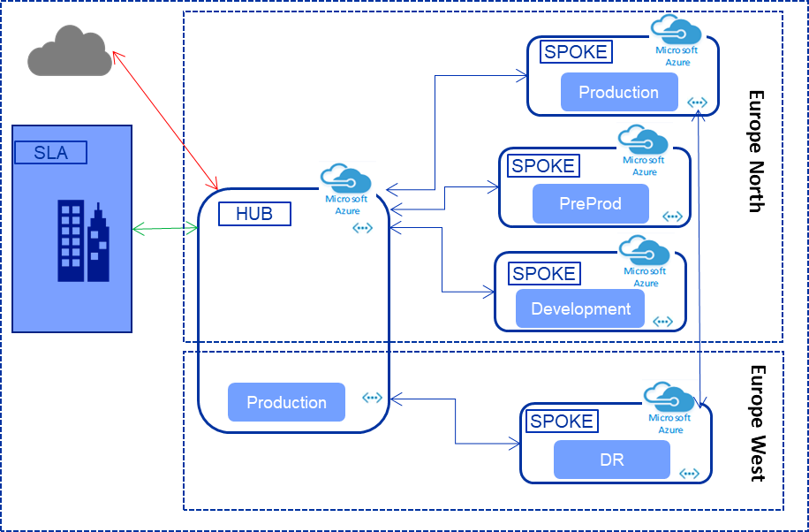
Solution Overview - Region
Key Points
Region: Azure Europe regions are selected - This should be noted as a provisional decision. The project needs to formally engage the SLA Data Privacy team and Risk and Compliance to ensure storing SLA data in the EU presents no compliance issues Express Route parameters eg bandwidth, (un)metered, post finalisation of applications to be migrated to Azure Seamless integration with existing Azure deployments in Europe. All critical services on IaaS are deployed in Availability Zone in both regions to have 99.99% SLA All critical PaaS services have at least 99.95% SLA

Slide 5
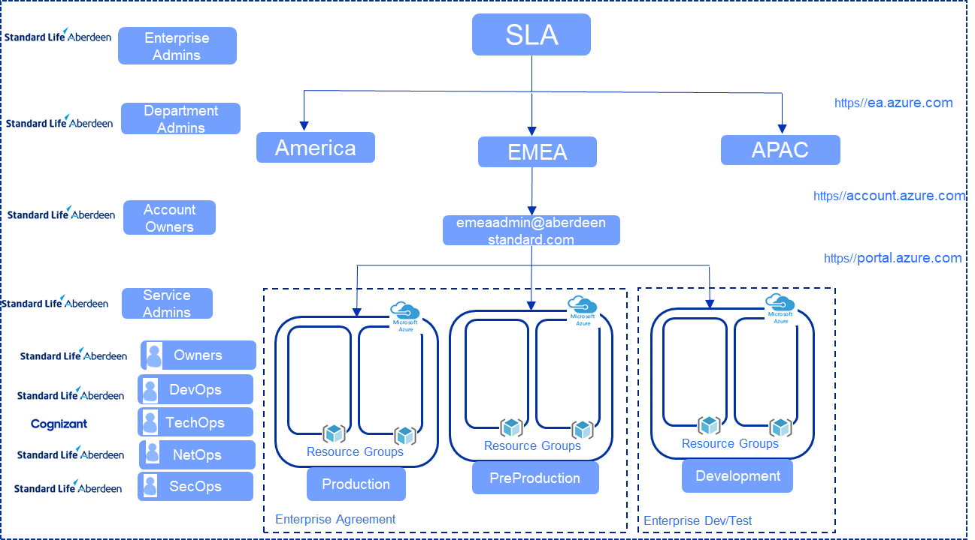
Solution Overview – EA and Subscriptions
Key Points
EA & Subscriptions: Considering the programme’s scope is UK Datacentres EMEA, geography based EA hierarchy is chosen All production and preproduction subscriptions are created in Enterprise Agreement to get benefits including savings All development subscriptions are created in Enterprise Dev/Test to get further savings Production and preproduction workloads would be setup identical for testing purpose Enterprise Administrator, Department Administrator, Account Owner and Service Administrator roles are owned by SLA

Slide 6
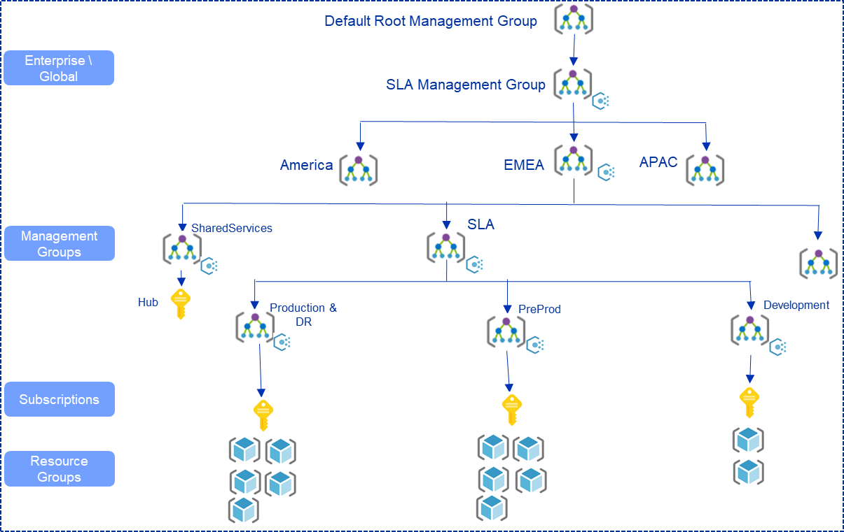
Solution Overview – Governance
Key Points
Governance: Management Groups hierarchy reflects the IT Operations – EMEA\ASI\Environments As Hub could be common for other businesses Management groups enable management of multiple subscriptions’ access, policies and compliance Existing Naming and Tagging standards to be used post validation Tagging is used for ownership identification, billing (showback/charge back), maintenance & downtime windows, etc

Slide 7
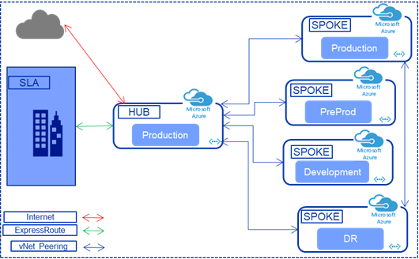
Solution Overview – SLA to Hub & Spoke
Key Points
SLA to Hub & Spoke: Isolates production, preproduction and development workloads where workloads deployed in their respective spokes. Separation of environments. Any communication between the environments blocked by default Shared services are deployed in the hub. All communications (Ingress and Egress to/from on-premise, internet and between environments) routed and filtered through Hub. Easy to add and remove spokes without affecting the rest of the network, giving business units great flexibility within their environments Overcome subscription limits Unique IP ranges to be allocated for environments

Slide 8
Solution Overview - Security
Security Outcomes
The Azure Foundations architecture will address security through a set of defined security outcomes achieved across SLA’s seven core security domains:
Identity
Network
Data
Endpoint
Monitoring
Testing
Governance
The detailed design activity and resulting HLD will define how the security outcomes are achieved by the architecture. The HLD definition of the architecture will present the detail of the security outcomes in one of two flavours:
The outcome is fully achieved; The architecture does not introduce any additional security risk into SLA.
This confirms that the outcome represents a standard enterprise level security control and is fully achieved throughout the architecture.
The outcome adopts a risk based approach.*
This confirms that the outcome represents a standard enterprise level security control but there has been some flexibility required in the level of achievement of the outcome. The SLA security team will assess with Cognizant what level of residual risk is presented to SLA, if that level of risk is acceptable and how any residual is mitigated after launch. Depending on the nature of the risk, some risks may need to be recorded on SLA’s operational risk registers for governance and audit purposes.
This will allow the SLA security architecture team to work with Cognizant to assess where the architecture defined within the HLD is:
Conformant All features in the architecture are designed in accordance with the security outcome.
Compliant Some features of the security outcome have not been achieved within the architecture.
Non-conformant The architecture is not designed in accordance with the security outcome.
*The SLA security team has worked with Cognizant to define which security outcomes could adopt a risk based approach within the architecture.

Slide 9
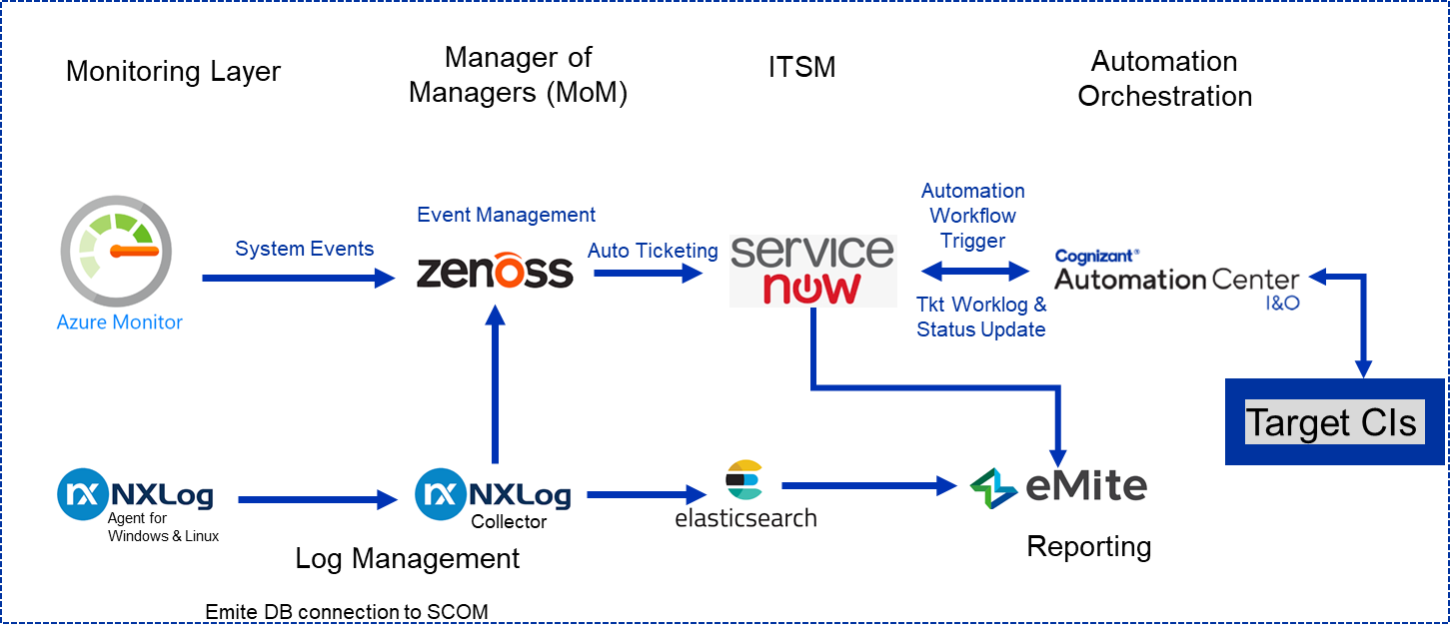
Solution Overview – Infrastructure Monitoring, Logging and Alerting
Key Points
Infrastructure Monitoring, Logging and Alerting: Existing on-prem solutions to be used Zenoss ServiceNow NXLog eMite Cognizant Automation Center I&O Azure Monitor to be integrated with Zenoss for event management Existing metrics to be used post validation Existing Service Level Agreements for production issues applicable Azure Networkwatcher to be deployed for Network services Security logging, monitoring and alerting will be addressed as part of the HLD and is not part of this diagram.

Slide 10
Solution Impact
Architecture Domain Impact:
Application Domain Impact:
Non Functional Impact:
Other Impact:
Overall Architecture Impact
Business Architecture
Application Architecture
Data Architecture
Technology & Infrastructure Architecture
IT Service Architecture
Security Architecture
Investments Public Markets
Investments Private Markets
Platforms
Distribution
Enterprise Solutions
Corporate
Overall Domain Impact
Performance
Data Security
RTO
RPO
Availability
User Scope
Overall
Non-Functional
Impact
Phoenix (P&S)
Phoenix (ITSO)
GDPR
Other Regulatory Obligations
SLA “Retained Business”
SL Group
WRAP
Elevate
NFR Narrative
Performance | As per Managed Service SLA’s
Data Security | Encryption at rest and in transit
RTO | As per Managed Service SLA’s
RPO | As per Managed Service SLA’s
User Scope | NA
Availability | As per Managed Service SLA’s
Solution Documentation Required
Solution Architecture Document | No
Application & Data Design | No
Infrastructure Design Document | Yes
Service Design Package | No
Supplier RFP/Due Diligence | No
Digital Advice
1825
360
Focus
Phoenix Impact Assessment
Are there any Phoenix users of the existing solution? | No
Is the existing solution used to deliver any services back to Phoenix? | No
Is the existing solution the source of any Phoenix data feeds? | No
Will the new solution result in any Operating Model changes for Phoenix, ASI or both? | SLA
Does the solution offer an opportunity to move Phoenix to our standard 3rd party operating model? | Yes
Impact Rating Key
High | Domain :: Significant changes to one or more key components within the domain/platform OR High number of key components being changed within domain/platform NFRs :: Challenging and requiring focussed attention
Medium | Domain :: Medium changes to a key component within the domain/platform OR High number of non-key components being changed within domain/platform NFRs :: Non standard and non trivial
Low | Domain :: Minor change to components within the domain/platform NFRs :: More of the same
None | Domain & NFRs :: No change to components within the domain/platform

Slide 11
Key Risks, Issues & Dependencies
Key Risks
Description | Likelihood | Impact | Possible mitigation options
May not get access required to SLA Architects on time due to they being involved in other commitment/ project activities resulting in delay in completing the Foundation Design | Medium | Medium | Foundation Design team to have a clear plan on who they need and when and book the time with Architects in advance so that clarity is gained on Requirements
If Azure UK Regions are to be selected for Azure Foundation Deployment, new Express Route circuits provisioning will result in additional cost, delay in Foundation setup and migration of workloads to Azure. | Medium | High | Use of Site to Site VPN for connectivity to Azure UK Regions until Express Route provisioned
Key Issues
Description | Possible Action Plan
Key Dependencies
Description | Dependency Type
Change Management approvals to deploy Azure Foundation | Hard
Licence procurement for services such as Firewall and end point protection | Medium
Provision of subscriptions and granting privileges to Cognizant Team prior to start the foundation build | Hard
SLA Architects and SMEs availability for pre and post build and sign off | Hard
Creation and sign off of a Target Operating Model of the implementation of the architecture. | Hard

Slide 12
What is SLAs choice of Tenant Options and Recommendation Decision Reference:
Governance Peer Review: {Date} Review: {Date} Approval: {Date}
Recommendation
Evaluation Criteria | Option 1 New Tenant | Option 2 Existing Tenant
Description | Introduce new Active Directory Tenant only services hosted in Azure Setup new Azure Active Directory Domain Services (AADDS) Deploy Azure DNS | Continue using existing Azure Active Directory tenant Setup Active Directory Domain Controllers with Integrated DNS on IaaS in Azure to extend on-premise Active Directory Directory Services
Tactical? | No | No
Pros | Segregation between on-premise users and Azure user account All PaaS services so no infrastructure management costs ADFS setup not required if users are only authenticating against AADDS. | Already setup, configured and functional Seamlessly enables migrations from on-premise to Azure DNS management for hybrid setup is simplified Single master list for all AD accounts
Cons | Multiple IAM services to manage JML process would need up to double the effort Integration with on-premise services becomes harder Users need to remember multiple credentials Multiple DNS services to manage All Azure migrations will become refactor or reengineer. | None identified
Impact on Costs (Project & BAU) | To implement this option: Project: £tbc BAU: £tbc | To implement this option: Project: N/A BAU: £tbc
Risk/Impact to Service | Risk: High Impact: High Network Impact Assessment: Not Required | Risk: Low Impact: Low Network Impact Assessment: Not Required

Slide 13
What is SLAs choice of Azure Region Options and Recommendation Decision Reference:
Governance Peer Review: {Date} Review: {Date} Approval: {Date}
Recommendation*
Evaluation Criteria | Option 1 UK | Option 2 Europe
Description | Azure Foundation deployed in Azure UK South Region and Azure UK West Region Setup new Express Route connectivity Establish connectivity between existing deployments in Azure Europe Regions and Azure UK regions Data resides in the UK Datacentres | Azure Foundation deployed in Azure Europe North Region and Azure Europe West Region Extend the existing Express Route connectivity in Azure Europe Regions to the new Azure Foundation setup Data resides n the Europe Datacentres
Tactical? | No | No
Pros | Better latency ~10ms Data resides in the UK datacentres should there be a need due to data compliance and sovereignty | No need for new Express Route connectivity Latency between existing deployments in Europe and new Foundation setup in Europe is better Both Primary and DR regions have Availability Zone which provides 99.99% availability Cost of some resources eg VMs are cheaper
Cons | Additional cost due to new Express Route connectivity Delays to foundation built caused by procurement and setup of new Express Route Azure UK West Region (DR) only supports Availability Set which gives maximum availability of 99.95% | Additional latency
Impact on Costs (Project & BAU) | To implement this option: Project: tbc BAU: tbc | To implement this option: Project: N/A BAU: £tbc
Risk/Impact to Service | Risk: Medium Impact: High Network Impact Assessment: Required | Risk: Low Impact: Low Network Impact Assessment: Not Required
*This should be noted as a provisional decision. The project needs to formally engage the SLA Data Privacy team and Risk and Compliance to ensure storing SLA data in the EU presents no compliance issues

Slide 14
What is SLAs choice of Azure Network Architecture Options and Recommendation Decision Reference:
Governance Peer Review: {Date} Review: {Date} Approval: {Date}
Recommendation
Evaluation Criteria | Option 1 Hybrid Model | Option 2 Hub and Spoke Model
Description | Shared Services, Production, Preproduction and Development resources grouped together in one subscription Multiple workload environments are co-hosted within the same virtual network to avoid additional peering between virtual networks. | Isolates production and non-production workloads where workloads deployed in their respective spokes. Separation of security concerns. Shared services are deployed in the hub. Any communication between the environments blocked by default. Routing and access controlled using Network security groups that specify rules to allow or deny traffic and user-defined routes that control the routing of packets.. Production, pre-production, Development and core services can be part of different subscriptions and network
Tactical? | No | No
Pros | Simple implementation with one virtual networks and no peering No need for additional routing component for communication between spokes | Core services and on-premise connectivity (transit gateway) shared between environments. Isolation of production and non-production environments. Easy to add and remove spokes without affecting the rest of the network, giving business units great flexibility within their environments. Central techops components (AD, Monitoring, backup etc.) deployed in a separate core network with strict security access controls Overcome subscription limits
Cons | No clear separation of security concerns Not fit for future expansion for adding additional virtual networks | Additional cost in maintaining virtual appliances for communication between spokes and peering bandwidth cost. All communications (Ingress and Egress) routed through Hub, which results in additional (minor) latency and cost. Potential bottleneck in communication between environments because of hopping through NVA/routing component in shared services virtual network
Impact on Costs (Project & BAU) | To implement this option: Project: N/A BAU: No | To implement this option: Project: N/A BAU: £0.008 per GB for ingress and egress for VNET peering within the same region
Risk/Impact to Service | Risk: High Impact: High Network Impact Assessment: Not Required | Risk: Low Impact: Low Network Impact Assessment: Not Required

Slide 15
What is SLAs choice of Business Continuity and Disaster Recovery Options and Recommendation Decision Reference:
Governance Peer Review: {Date} Review: {Date} Approval: {Date}
Recommendation
Evaluation Criteria | Option 1 One Region | Option 2 Two Regions
Description | Datacentre failures within a region can be overcome by using availability zones which gives up to 99.99% availability Backups are stored in zone redundant storages | Primary region’s paired region is selected for DR Region failures can be overcome by restoring services in DR region Backups are stored in geo redundant storages
Tactical? | No | No
Pros | As no geo replication storage required, less costly No infrastructure and management costs related to secondary region | Provide significantly better geographic redundancy – Regions are over 300 miles apart. Active/Active DR would provide availability over 99.99%
Cons | NO DR - Redundancy is ONLY within one regional datacentres Datacentres within a region are located within a short radius, therefore a regulatory compliant DR solution can not be provided. | Some shared services eg firewall need to be available in DR region, thus additional costs
Impact on Costs (Project & BAU) | To implement this option: Project: N/A BAU: N/A | To implement this option: Project: £tbc BAU: £tbc
Risk/Impact to Service | Risk: High Impact: High Network Impact Assessment: Not Required | Risk: Low Impact: Low Network Impact Assessment: Not Required

Slide 16
Post Implementation Solution Architecture Review
This section is only to be added in the Closure phase of the project

Slide 17
Gaps & Deviations From Target
Compare the agreed Solution Architecture to what was actually designed and implemented. Identify any significant gaps/deviations and the rationale behind them, and also what future action (if any) is required to close these gaps.

Slide 18
Closure Checklist
Use this section to evidence that all required close down tasks have been carried out.
Checklist Item | Yes/No/NA | Comments (Required for No & NA answers)
Has the solution overview document been updated?
Has the solution architecture document been updated?
Has the application catalogue been updated?
Has the technology catalogue been updated?
Have the datastore & interface catalogues been updated?
Has the service catalogue been updated?
Has the CMDB been updated?
Has knowledge database(s) been updated?
Has the Qvidean RFP response store been updated?
Has the ClearView BCP system been updated?
Has domain backlog(s) been updated?
Has domain risk log(s) been updated?

